Slide 1
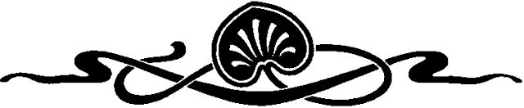
COMPUTER GRAPHICS
Hochiminh city University of Technology
Faculty of Computer Science and Engineering
CHAPTER 8:
Lighting and Shading

Slide 2
OUTLINE
Introduction
Shading model
Flat shading & smooth shading
Using Light Sources in OpenGL
Working with material in OpenGL
Computation of Vectors

Slide 3
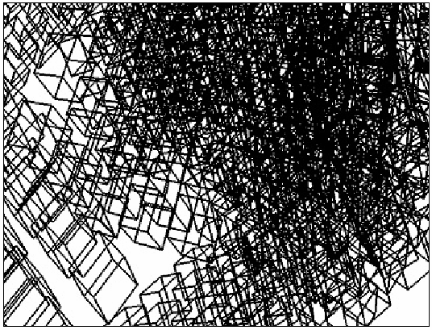
Introduction
Wireframe
Simple, only edges of each object are drawn
Can see through object
It can be difficult to see what’s what

Slide 4
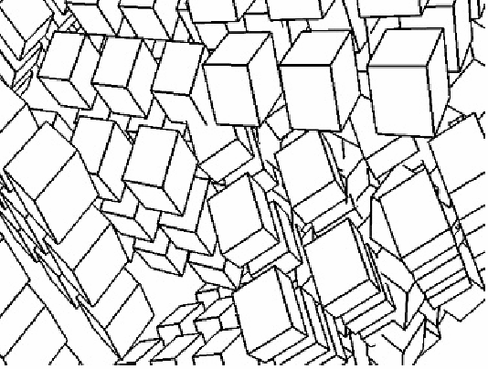
Introduction
Line Drawing: wire-frame with hidden surface removal
Only edges are drawn
The objects now look solid, and it is easy to tell where one stops and the next begins

Slide 5
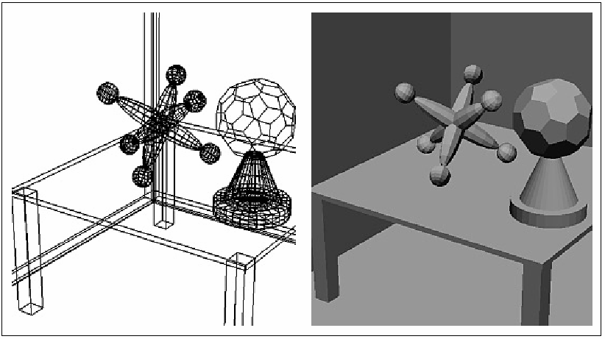
Introduction
Flat shading:
A calculation of how much light is scattered from each face is computed at a single point.
All points in a face are rendered with the same gray level
Can see the Boundary between polygons

Slide 6
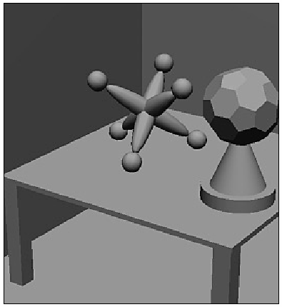
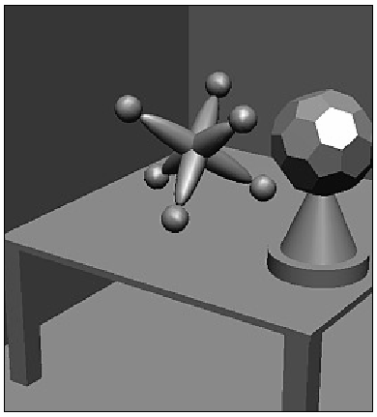
Introduction
Smooth shading (Gouraud shading):
Different points of a face are drawn with different gray levels found through an interpolation scheme
The edges of polygons disappear
specular

Slide 7
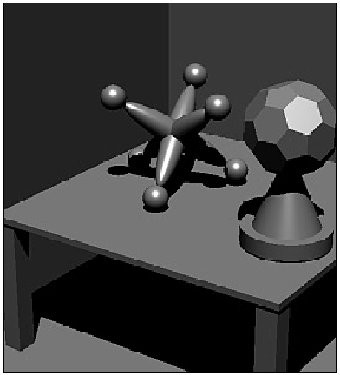
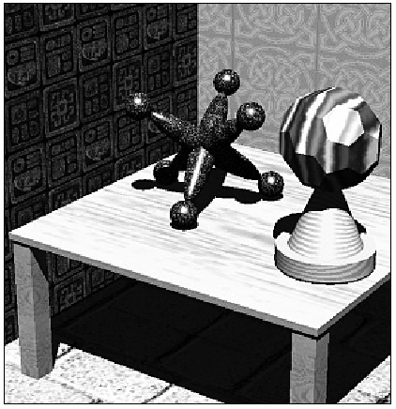
Introduction
Adding texture, shadow

Slide 8
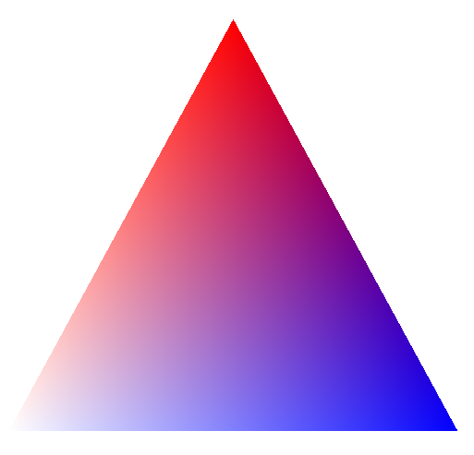
Introduction
Before Projection
Physical Model
After Projection
Mathematical Model

Slide 9

Shading model
Light sources “shine” on the various surfaces of the objects, and the incident light interacts with the surface in three different ways:
Some is absorbed by the surface and is convert to heat
Some is reflected from the surface
Some is transmitted into the interior of the objects, as in the case of a piece of glass.

Slide 10
Shading model
Two types of reflection of incident light:
Diffuse: re-radiated uniformly in all directions. Interacts strongly with the surface, so it color is usually affected by the nature of material.
Specular: highly directional, incident light doesnot penetrate the object, but instead is reflected directly from its outer surface. The reflected light has the same color as incident light.

Slide 11
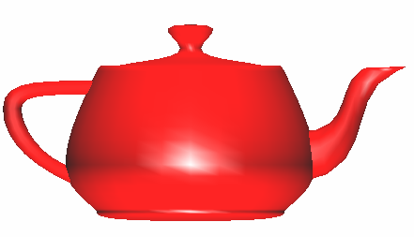
Shading model
Why does the image of a real teapot look like
Light-material interactions cause each point to have a different color or shade
To calculate color of the object, need to consider:
Light sources
Material properties
Location of viewer
Surface orientation

Slide 12
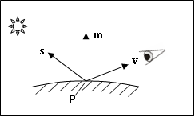
Shading model
Geometric ingredients for finding reflected light
The normal vector m to the surface at P
The vector v from P to the viewer’s eye
The vector s from P to the light source

Slide 13
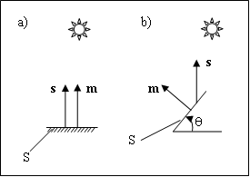
Shading model
Computing the Diffuse Component
Diffuse component with an intensity denoted by I_{d}
Scattering uniform in all directions → depend only on m, s
Lambert’s law:
I_{s}: intensity of light source, ρ_{d} : diffuse reflection coefficient

Slide 14
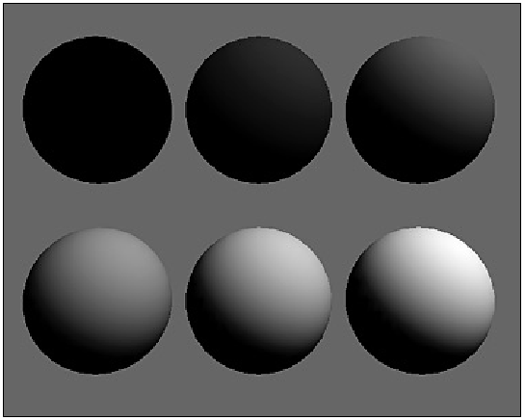
Shading model
Computing the Diffuse Component
diffuse reflection coefficient : 0, 0.2, 0.4, 0.6, 0.8, 1.0

Slide 15
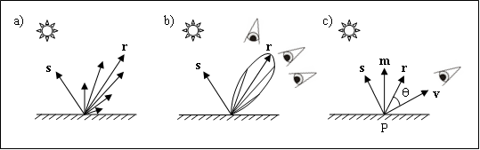
Shading model
Specular Reflection
Specular reflection causes highlights, which can add significantly to the realism of a picture when objects are shiny
The amount of light reflected is greated in the direction r.
f : [1, 200]

Slide 16
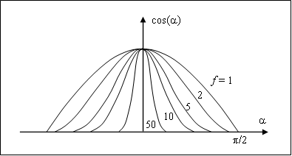
Shading model
Specular Reflection
As f increase, the reflection becomes more mirror like and is more highly concentrated along the direction r.

Slide 17
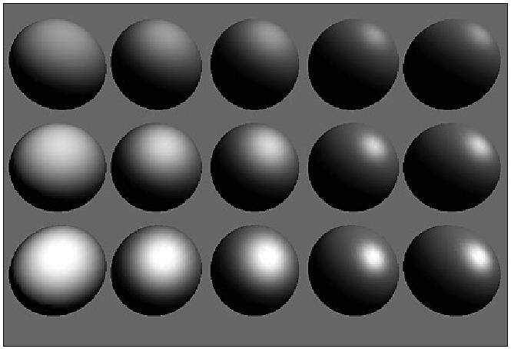
Shading model
Specular Reflection
ρ_{s} from top to bottom: 0.25, 0.5, 0.75. f from left to right: 3, 6, 9, 25, 200

Slide 18
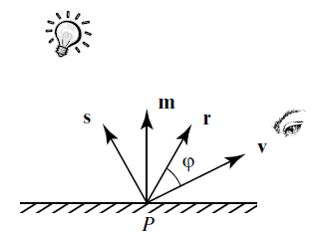
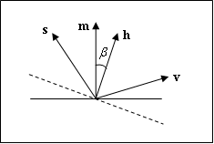
Shading model
Specular Reflection
Reduce computation time, use halfway vector h = s + v.
Use β as the approximation of angle between r and v

Slide 19
Shading model
Ambient Light

Slide 20
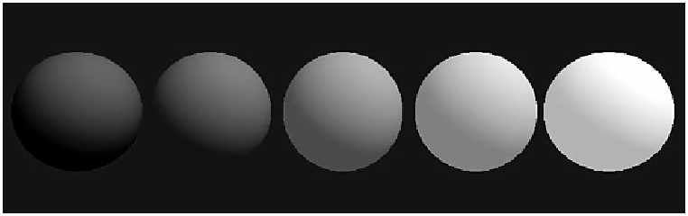
Shading model
Ambient Light
To overcome the problem of totally dark shadows, we imagine that a uniform “background glow” called ambient light exist in the environment
Not situated at any particular place, and spreads in all direction uniformly
The source is assigned an intensity I_{a}. ρ_{a}: ambient reflection coefficient.

Slide 21
Shading Model
0.9, 0.1, 0.4
0.3, 0.2, 0.5
-----------------
1.0, 0.3, 0.9

Slide 22
Shading model
Combining Light Contribution
Adding color

Slide 23
Introduction
X1, Y1, Z1
color1
x1, y1
color1
X2, Y2, Z2
X3, Y3, Z3
x2, y2
x3, y3
color2
color3
color2
color3
Before Projection
Physical Model
After Projection
Mathematical Model

Slide 24
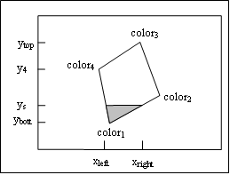
Flat shading & smooth shading
Painting a face
The pixels in a polygon are visited in a regular order, usually scan line by scan line from bottom to top, and across each scan line from left to right
Convex polygons can be made highly efficient, since, at each scan line, there is a single unbroken “run” of pixels.
for (int y = ybott ; y <= ytop ; y++) {
find xleft and xright;
for (int x = xleft; x <= xright; x++) {
find the color c for this pixel;
put c into the pixel at (x, y); } }

Slide 25
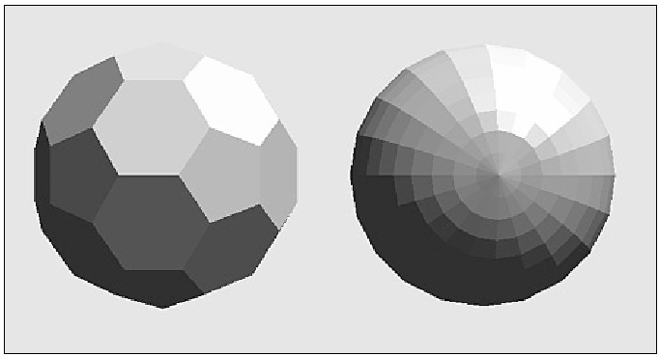
Flat shading & smooth shading
Flat shading
Face is flat, light source are quite distant → diffuse light component varies little over different points
glShadeModel(GL_FLAT);
for (int y = ybott ; y <= ytop ; y++) {
find xleft and xright;
find the color c for this scan line;
for (int x = xleft; x <= xright; x++) {
put c into the pixel at (x, y); } }

Slide 26
Flat shading & smooth shading
Flat Shading
(xleft – x4)/(xleft – x1) = (cl – color4)/(cl-color1)
x3, y3
x4, y4
(xright – x2)/(xright – x1) = (cr – color2)/(cr-color1)
x2, y2
x1, y1

Slide 27
Flat shading & smooth shading
Smooth shading – Gouraud shading
color_{left} = lerp(color₁, color₄, f),
for (int y = ybott ; y <= ytop ; y++){
find xleft and xright;
find colorleft and colorright;
colorinc = (colorright – colorleft)/ (xright – xleft)
for (int x = xleft, c = colorleft; x <= xright; x++, c += colorinc ) {
put c into the pixel at (x, y);}}

Slide 28
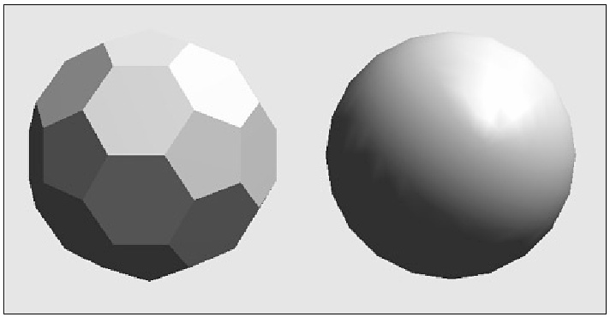
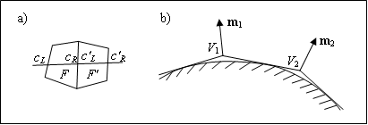
Flat shading & smooth shading
Smooth shading – Gouraud shading
glShadeModel(GL_SMOOTH);

Slide 29
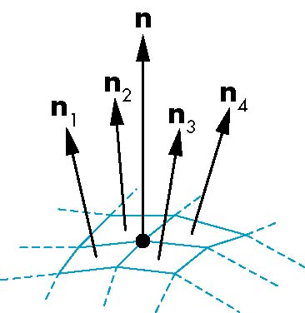
Flat shading & smooth shading
Smooth shading – Gouraud shading
For polygonal models, Gouraud proposed we use the average of the normals around a mesh vertex
n = (n₁+n₂+n₃+n₄)/ |n₁+n₂+n₃+n₄|

Slide 30
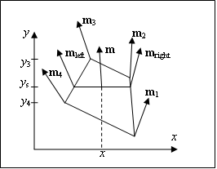
Flat shading & smooth shading
Smooth shading – Phong shading
Slow calculation, better realism
OpenGL doesn’t support

Slide 31

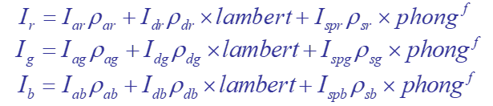

Steps in OpenGL shading
-Enable shading and select model
-Specify normal
-Specify lights
-Specify material properties

Slide 32
Enabling Shading
Shading calculations are enabled by
glEnable(GL_LIGHTING)
Once lighting is enabled, glColor() ignored
Must enable each light source individually
glEnable(GL_LIGHTi) i=0,1…..

Slide 33
Specify normals
In OpenGL the normal vector is part of the state
Set by glNormal*()
glNormal3f(x, y, z);
glNormal3fv(p);
Usually we want to set the normal to have unit length so cosine calculations are correct
glEnable(GL_NORMALIZE) allows for autonormalization at a performance penalty

Slide 34
Using Light Sources in OpenGL
Creating a light Source
- Position
GLfloat myLightPosition[] = {3.0, 6.0, 5.0, 1.0};
glLightfv(GL_LIGHT0, GL_POSITION, myLightPosition);
(x, y, z, 1) →point light source, (x, y, z, 0)→directional light source
- Color
GLfloat amb0[] = {0.2, 0.4, 0.6, 1.0};
GLfloat diff0[] = {0.8, 0.9, 0.5, 1.0};
GLfloat spec0[] = {1.0, 0.8, 1.0, 1.0};
glLightfv(GL_LIGHT0, GL_AMBIENT, amb0);
glLightfv(GL_LIGHT0, GL_DIFFUSE, diff0);
glLightfv(GL_LIGHT0, GL_SPECULAR, spec0);

Slide 35
Using Light Sources in OpenGL
Creating a light source
- Color
GLfloat amb0[] = {0.2, 0.4, 0.6, 1.0};
GLfloat diff0[] = {0.8, 0.9, 0.5, 1.0};
GLfloat spec0[] = {1.0, 0.8, 1.0, 1.0};
glLightfv(GL_LIGHT0, GL_AMBIENT, amb0);
glLightfv(GL_LIGHT0, GL_DIFFUSE, diff0);
glLightfv(GL_LIGHT0, GL_SPECULAR, spec0);

Slide 36
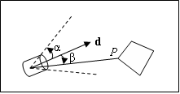
Using Light Sources in OpenGL
Splotlights
glLightf(GL_LIGHT0, GL_SPOT_CUTOFF, 45.0); // angle
glLightf(GL_LIGHT0, GL_SPOT_EXPONENT, 4.0); // ε = 4.0
GLfloat dir[] = {2.0, 1.0, -4.0}; // direction
glLightfv(GL_LIGHT0, GL_SPOT_DIRECTION, dir);

Slide 37
Working with material in OpenGL
GLfloat myColor[] = {0.8, 0.2, 0.0, 1.0};
glMaterialfv(GL_FRONT, GL_DIFFUSE, myColor);
GL_BACK, GL_FRONT_AND_BACK
GL_AMBIENT, GL_SPECULAR,GL_EMISSION

Slide 38
Working with material in OpenGL
GLfloat ambient[] = {0.2, 0.2, 0.2, 1.0};
GLfloat diffuse[] = {1.0, 0.8, 0.0, 1.0};
GLfloat specular[] = {1.0, 1.0, 1.0, 1.0};
GLfloat shine = 100.0
glMaterialfv(GL_FRONT, GL_AMBIENT, ambient);
glMaterialfv(GL_FRONT, GL_DIFFUSE, diffuse);
glMaterialfv(GL_FRONT, GL_SPECULAR, specular);
glMaterialf(GL_FRONT, GL_SHININESS, shine);

Slide 39
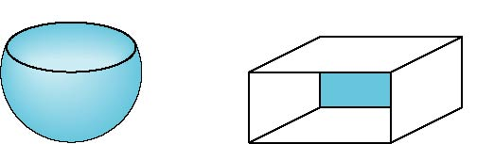
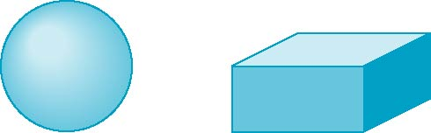
Front and Back Faces
The default is shade only front faces which works correctly for convex objects
If we set two sided lighting, OpenGL will shade both sides of a surface
Each side can have its own properties which are set by using GL_FRONT, GL_BACK, or GL_FRONT_AND_BACK
back faces not visible
back faces visible
Xem Video Clip: Chương 3 – Phần 7

Slide 40
Front and Back Faces
Specify Front Faces
glFrontFace(GL_CCW), glFrontFace(GL_CW)
Cull Face
glEnable(GL_CULL_FACE)
glCullFace(GLenum mode);
GL_FRONT,
GL_BACK,
GL_FRONT_AND_BACK
Xem Video Clip: Chương 3 – Phần 7

Slide 41
Computation of Vectors
s and v are specified by the application
Can compute r from s and m
Problem is determining m
For simple surfaces is can be determined but how we determine m differs depending on underlying representation of surface
OpenGL leaves determination of normal to application

Slide 42
Computation of Vectors
If the face is flat → face’s normal vector is vertices normal vector
m = (V1 – V2) x (V3 – V4)
Two problem: 1) two vector nearly parallel, 2) not all the vertices lie in the same plane
- next(j) = (j + 1) mod N
- Traversed in CCW
- m outward

Slide 43
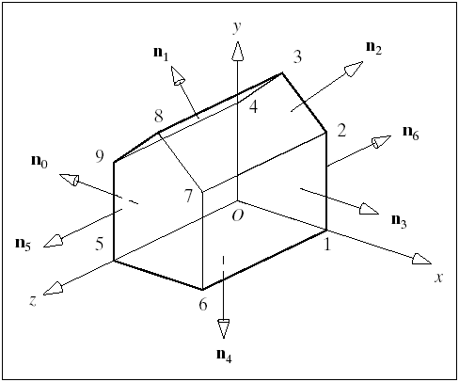
Computation of Vectors

Slide 44
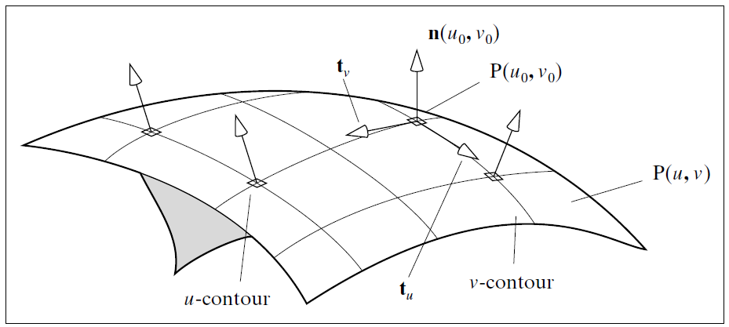
Computation of Vectors
Normal vector for a surface given parametrically

Slide 45
Computation of Vectors
Normal vector for a surface given implicitly
EX: the implicit form of plane:
F(x, y, z) = n • ((x, y, z) – A) = 0
or: n_{x}x + n_{y}y + n_{z}z - n•A =0
→ normal is (n_{x}, n_{y}, n_{z})

Slide 46
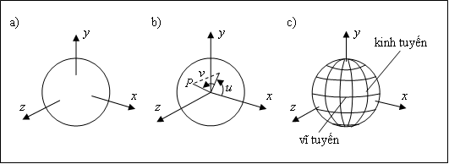
Generic Shapes
The sphere:
Implicit form F(x, y, z) = x² + y² + z² – 1
→ normal (2x, 2y, 2z)
Parametric form p(u, v) = (cos(v)cos(u), cos(v)sin(u), sin(v))

Slide 47
Generic Shapes
The sphere
Parametric form p(u, v) = (cos(v)cos(u), cos(v)sin(u), sin(v))
dp/du = (-cos(v)sin(u), cos(v)cos(u), 0)
dp/dv = (-sin(v)cos(u), -sin(v)sin(u), cos(v))
n(u, v) = (dp/du) x (dp/dv) = cos(v)p(u,v)

Slide 48
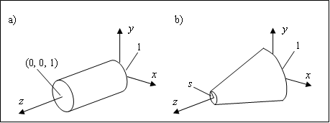
Generic Shapes
Cylinder:
Implicit form F(x, y, z) = x² + y² – (1 + (s – 1)z)² 0< z<1 → n(x, y, z) = (x, y, -(s – 1)(1 + (s -1)z))
Parametric form
P(u, v) = ((1 + (s – 1)v)cos(u), (1 + (s – 1)v)sin(u), v)
→ n(u, v) = (cos(u), sin(u), 1-s)

Slide 49
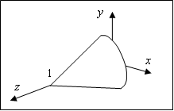
Generic Shape
Cone
- Implicit: F(x, y, z) = x² + y² – (1 – z)² = 0 0 < z < 1
→n = (x, y, 1 – z)
parametric P(u, v) = ((1 – v) cos(u), (1 – v)sin(u), v)
→n(u, v) = (cos(u), sin(u), 1)

Slide 50
Further Reading
“Interactive Computer Graphics: A Topdown Approach Using OpenGL”, Edward Angel
Chapter 6: Lighting and Shading
“Đồ họa máy tính trong không gian ba chiều”, Trần Giang Sơn
Chương 3: Tô màu vật thể ba chiều (3.1 → 3.4)

